Slide 1
Browser-based Virtual Reality with html5
tony parisi
April, 2015

Slide 2


about me
contact
tparisi@gmail.com
skype: auradeluxe http://twitter.com/auradeluxe http://www.tonyparisi.com/
http://www.learningwebgl.com/
Creds
Co-creator, VRML and X3D
Work
http://www.thirdeye.gl/
meetups
http://www.meetup.com/WebGL-Developers-Meetup/
http://www.meetup.com/Web-VR/
get GLAM
http://www.glamjs.org/
https://github.com/tparisi/glam/
book code
https://github.com/tparisi/WebGLBook
https://github.com/tparisi/Programming3DApplications
get the books!
WebGL: Up and Running
http://www.amazon.com/dp/144932357X
Programming 3D Applications with HTML and WebGL
http://www.amazon.com/Programming-Applications-HTML5-WebGL-Visualization/dp/1449362966

Slide 3

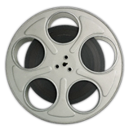
VR APPS TODAY
Giant downloads
App store installs
Proprietary stacks
Closed culture
Experts only!

Slide 4

Web apps today
Instant access
No gatekeepers
Instant publishing
Your choice of tools
Culture of collaboration
Source code
No barriers to entry
image: Mark Surman
http://commonspace.wordpress.com/2014/03/12/happybirthday/

Slide 5
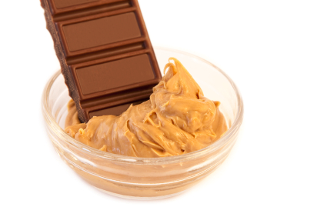
The Web + VR two great tastes… ?

Slide 6

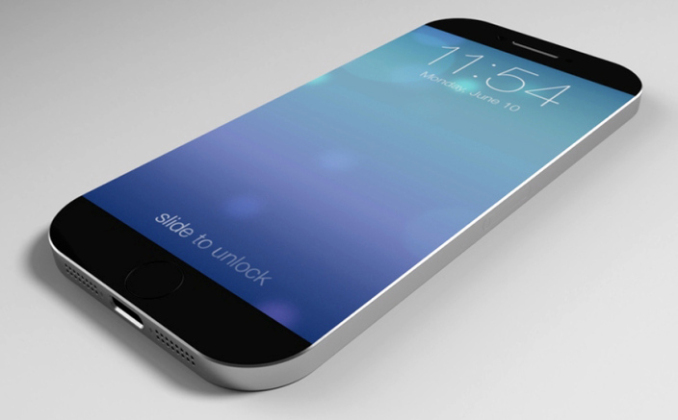
Your browser already does 3D
WebGL is on all desktop mobile browsers
3B seats.
Q.E.D.

Slide 7
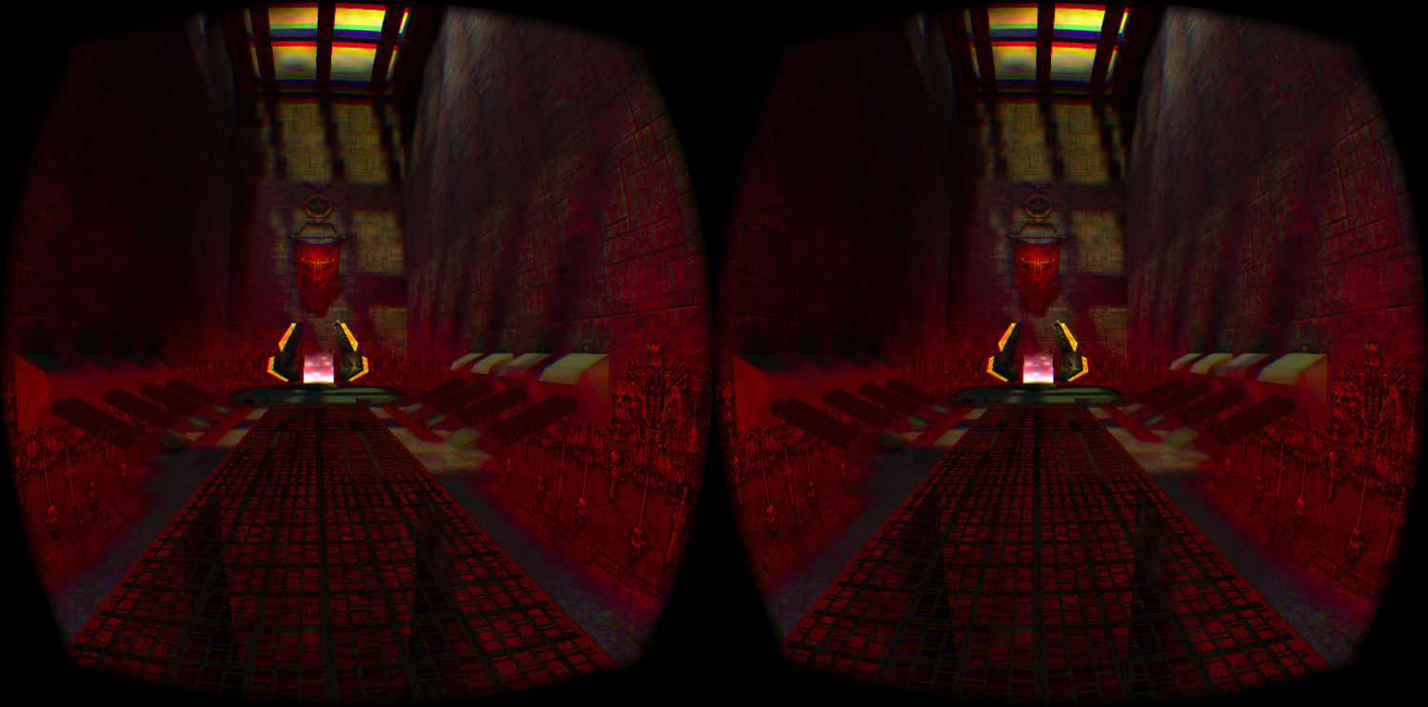
Soon – It will do VR, TOO
WebVR API
Head-Tracking and Fullscreen VR Support Now in Browser Builds!!! (SOON IN NIGHTLY CHANNEL!!!)
No Big App Downloads and Installs!!!
http://mozvr.github.io/webvr-spec/webvr.html
Quake 3 WebVR demo, developed by Brandon Jones of Google
http://media.tojicode.com/q3bsp/

Slide 8
The WebVR API
NOTE: this API is changing as we speak; will update the example details shortly
Query for VR Device(s) to Render
// polyfill
var getVRDevices = navigator.mozGetVRDevices /* FF */ ||
navigator.getVRDevices; /* webkit */
var self = this;
getVRDevices().then( gotVRDevices );
function gotVRDevices( devices ) {
var vrHMD;
var error;
for ( var i = 0; i < devices.length; ++i ) {
if ( devices[i] instanceof HMDVRDevice ) {
vrHMD = devices[i];
self._vrHMD = vrHMD;
self.leftEyeTranslation = vrHMD.getEyeTranslation( "left" );
self.rightEyeTranslation = vrHMD.getEyeTranslation( "right" );
self.leftEyeFOV = vrHMD.getRecommendedEyeFieldOfView( "left" );
self.rightEyeFOV = vrHMD.getRecommendedEyeFieldOfView( "right" );
break; // We keep the first we encounter
}
}
}
get left/right eye
(camera) positions
get per-eye camera field of view; use WebGL to render scene from two cameras

Slide 9
The WebVR API
Go Fullscreen (VR Mode)
var self = this;
var renderer = this._renderer;
var vrHMD = this._vrHMD;
var canvas = renderer.domElement;
var fullScreenChange =
canvas.mozRequestFullScreen? 'mozfullscreenchange' : 'webkitfullscreenchange';
document.addEventListener( fullScreenChange, onFullScreenChanged, false );
function onFullScreenChanged() {
if ( !document.mozFullScreenElement
&& !document.webkitFullScreenElement ) {
self.setFullScreen( false );
}
}
if ( canvas.mozRequestFullScreen ) {
canvas.mozRequestFullScreen( { vrDisplay: vrHMD } );
} else {
canvas.webkitRequestFullscreen( { vrDisplay: vrHMD } );
}
fullscreen mode requires a DOM element
handle exiting fullscreen mode
request fullscreen mode
for this VR device

Slide 10
The WebVR API
Head Tracking
// polyfill
var getVRDevices = navigator.mozGetVRDevices /* FF */ ||
navigator.getVRDevices; /* webkit */
var self = this;
getVRDevices().then( gotVRDevices );
function gotVRDevices( devices ) {
var vrInput;
var error;
for ( var i = 0; i < devices.length; ++i ) {
if ( devices[i] instanceof PositionSensorVRDevice ) {
vrInput = devices[i]
self._vrInput = vrInput;
break; // We keep the first we encounter
}
}
}
…
// called once per tick from requestAnimationFrame()
var update = function() {
var vrState = this.getVRState();
if ( !vrState ) {
return;
}
// vrState.hmd.rotation contains four floats, quaternion x,y,z,w
setCameraRotation(vrState.hmd.rotation);
};
get head-tracking VR device
query HMD device state
update camera to match HMD device orientation

Slide 11
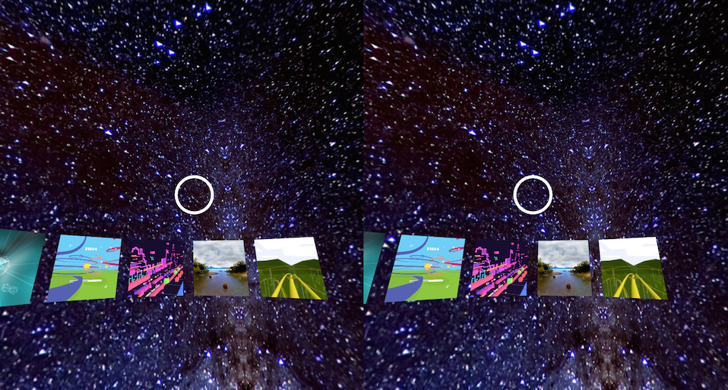
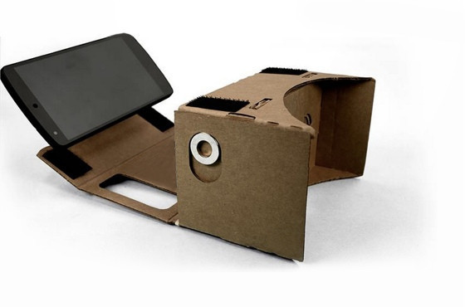

WebVR and Cardboard
Google Cardboard Showcase
Mobile Chrome http://g.co/chromevr
Desktop Chrome http://vr.chromeexperiments.com/
Even Easier Than Oculus!
Render WebGL Side-by-Side Stereo (no need to query devices)
Use Existing Browser Fullscreen Mode
Use browser Device Orientation API for Head Tracking

Slide 12
WebVR And Three.js
The Most Popular WebGL Library
http://threejs.org/
Latest Stable version (r68) includes Stereo Rendering and Head Tracking
Rendering
examples/js/effects/StereoEffect.js (Cardboard)
examples/js/effects/VREffect.js (Rift)
Head Tracking
examples/js/controls/DeviceOrientationControls.js (Cardboard)
examples/js/controls/VRControls.js (Rift)
New Dev branch of Three.js has recent API updates…

Slide 13
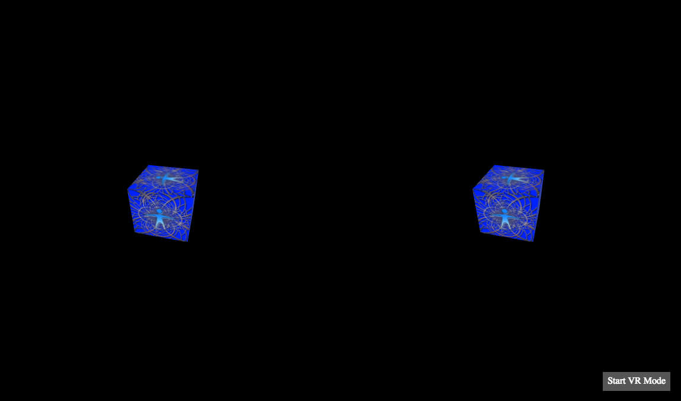
Let’s Build Something
Code
https://github.com/tparisi/WebVR
Demo
http://tparisi.github.io/WebVR/examples/cube-oculus.html

Slide 14
Open tools for Cross-platform VR
game engines/IDEs
Goo Engine *http://www.gootechnologies.com/
Verold http://verold.com/ *
Turbulenz https://turbulenz.com/
PlayCanvas http://www.playcanvas.com/
Sketchfab https://sketchfab.com/
Unreal *https://www.unrealengine.com/
Unity * http://unity3d.com/#unity-5
scene graph libraries/page frameworks
Three.js
http://threejs.org/
SceneJS
http://scenejs.org/
BabylonJS
http://www.babylonjs.com/
GLAM
https://github.com/tparisi/glam
video players
eleVR
https://github.com/hawksley/eleVR-Web-Player
Littlstar
https://github.com/littlstar/slant-player
* not open source

Slide 15
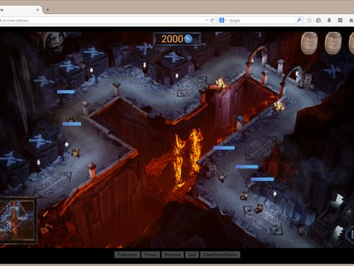
Pro Tools for Web VR
Emscripten - the coolest hack ever!
https://github.com/kripken/emscripten
Cross-compile C++ native code to JavaScript
asm.js- low-level optimized JavaScript
Unity, Unreal Engines use this to deploy on the web
Watch Out: Huge downloads and hard to debug…. !
Unreal 4 in WebGL
https://developer.mozilla.org/en-US/demos/detail/unreal-engine-4-strategy-game
60FPS
Unreal native C++ engine -> JavaScript
Emscripten + asm.js

Slide 16
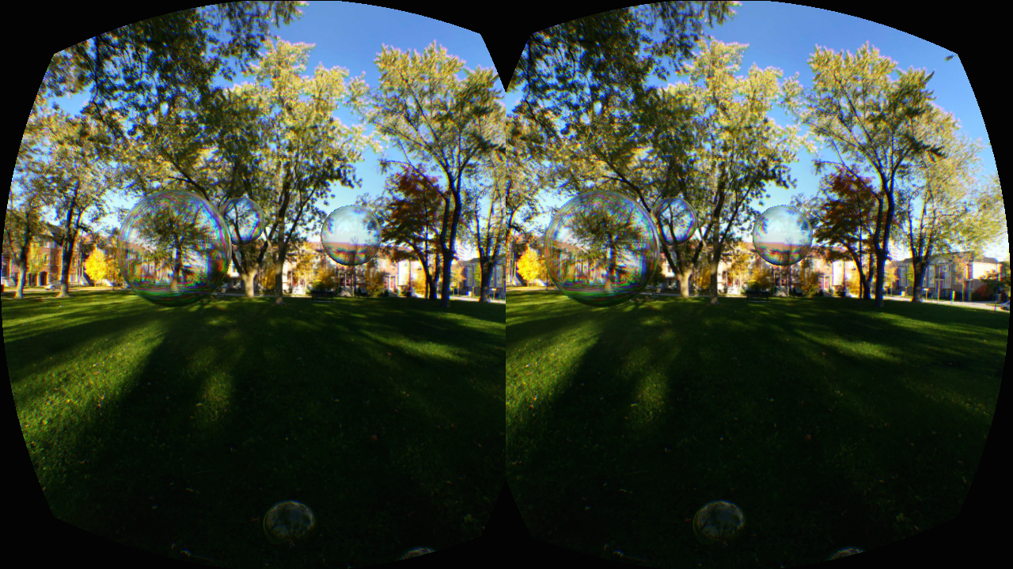
VR + ML A Markup Language for the metaverse?
GLAM (GL And Markup) - a declarative language for 3D web content
https://github.com/tparisi/glam/
define 3D scene content in markup; style it in CSS
The Markup
The CSS
<style>
.skybox {
envmap-right:url(../images/Park2/posx.jpg);
…
}
.bubble {
radius:.5;
shader-vertex:url(../shaders/fresnel.vs);
shader-fragment:url(../shaders/fresnel.fs);
shader-uniforms:mRefractionRatio f 1.02 mFresnelBias f 0.1 mFresnelPower f 2.0 mFresnelScale f 1.0 tCube t null;
}
#sb1 {
background-type:box;
}
</style>
<glam>
<renderer type="rift"></renderer>
<scene>
<controller type="rift"></controller>
<background id="sb1" class="skybox">
</background>
<group y ='1' z='-3'>
<sphere class="bubble skybox”>
</sphere>
<sphere class="bubble skybox”>
</sphere>
</group>
…
Or check out SceneVR from Ben Nolan
http://twitter.com/scenevr/

Slide 17
Challenges
WebVR on Oculus is not ready for prime time
(That’s OK neither is Oculus!)
Latency is the biggest issue – Browser needs to un-throttle at 60fps (It’s in the works…)
Device Drivers and Display Modes SUUUUUUCK #tellmesomethingidontkow
But we’re good to go on Cardboard!
60fps works great (ish)
Nearly 2 billion VR devices already deployed!
Frameworks and tools are typically web-ish: under development, always in flux, pretty much out of control
But open source so we can live with it

Slide 18
Links
Browser Dev Builds
Firefox http://blog.bitops.com/blog/2014/08/20/updated-firefox-vr-builds/
Chrome https://drive.google.com/folderview?id=0BzudLt22BqGRbW9WTHMtOWMzNjQ
Mozilla VR Showcase
http://mozvr.com/
WEBVR Mailing List
web-vr-discuss@mozilla.org
Cardboard VR Showcase
http://vr.chromeexperiments.com/
Web VR Example Code
https://github.com/tparisi/WebVR

Slide 19

COMING Summer 2015

Slide 20
Browser-based Virtual Reality with html5
tony parisi
April, 2015

